Slide 1
Notation and Organization are
Everything

Slide 2
Start as far away from Ein as possible
Z34=

Slide 3
Keep combining, drawing, documenting
Z1-4=

Slide 4
Start working back with Ohm’s law, KVL, and KCL
I₁₋₄=

Slide 5
Start working back with Ohm’s law, KVL, and KCL
I₁=
V₁=
I₂=
V₂=
I₃₄=
V₃₄=

Slide 6
Notation and Organization are
Everything
I₃=
V₃₄=
I₄=
V₃=
I₃₄=
KCL check
V₄=
KVL check

Slide 7
Finally, get your calculator out.
Go back thru the plan and put the numbers to the right.
I₃=
V₃₄=
I₄=
V₃=
I₃₄=
check
V₄=

Slide 8
Problem 2 – I_{Z4}

Slide 9
Problem 2 – I_{Z4}

Slide 10
Problem 2 – I_{Z4}
Z₃₄=
Z₆₇=

Slide 11
Problem 2 – I_{Z4}
Z₃₇=

Slide 12
Problem 2 – I_{Z4}
Z₂₇=
I₂₇=
V₂₇=

Slide 13
Problem 2 – I_{Z4}
V₃₇=
I₃₇=

Slide 14
Problem 2 – I_{Z4}
I₃₄=
V₃₄=

Slide 15
Problem 2 – I_{Z4}
V₄=
I₄=

Slide 16
Problem 2

Slide 17
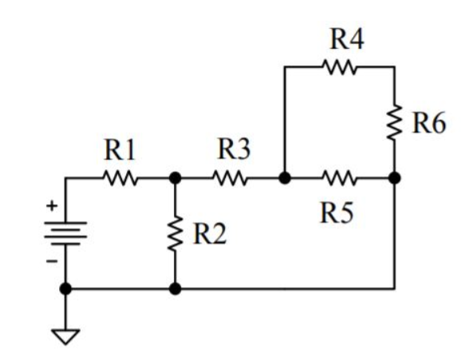
Problem 3 – calculate all V and I

Slide 18
Problem 3 – calculate all V and I

Slide 19
Problem 3 – calculate all V and I

Slide 20
Problem 3 – calculate all V and I

Slide 21
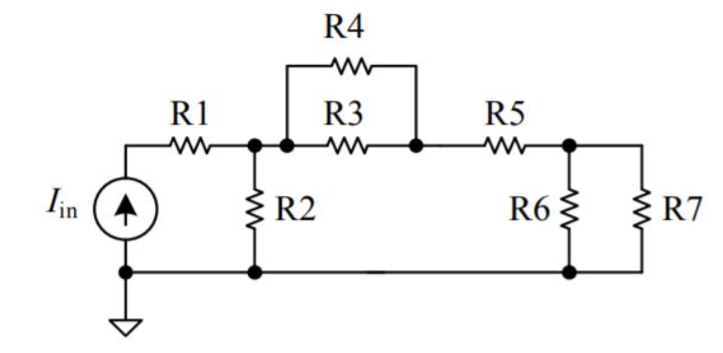
Problem 4 – calculate all V and I

Slide 22
Problem 4 – calculate all V and I

Slide 23
Problem 4 – calculate all V and I

Slide 24
Problem 4 – calculate all V and I

Slide 25
Problem 4 – calculate all V and I

